Slide 1
NORMALISATION

Slide 2
Objectives
normalise a relation to Boyce Codd Normal Form (BCNF)
normalise arelation to forth normal form (4NF)
normalise arelation to fifth normal form (5NF)

Slide 3
Boyce-Codd Normal Form (BCNF)
When a relation has more than one candidate key, anomalies may result even though the relation is in 3NF.
3NF does not deal satisfactorily with the case of a relation with overlapping candidate keys
  i.e. composite candidate keys with at least one attribute in common.
BCNF is based on the concept of a determinant.
- A determinant is any attribute (simple or composite) on
which some other attribute is fully functionally dependent.
A relation is in BCNF is, and only if, every determinant is a candidate key.

Slide 4
BCNF
Consider the following relation and determinants. R( a,b,c,d )
a,c -> b,d
a,d -> b
To be in BCNF, all valid determinants must be a candidate key. In the relation R, a,c ->b,d is the determinate used, so the first determinate is fine.
a,d ->b suggests that a,d can be the primary key, which would determine b. However this would not determine c. This is not a candidate key, and thus R is not in BCNF.

Slide 5
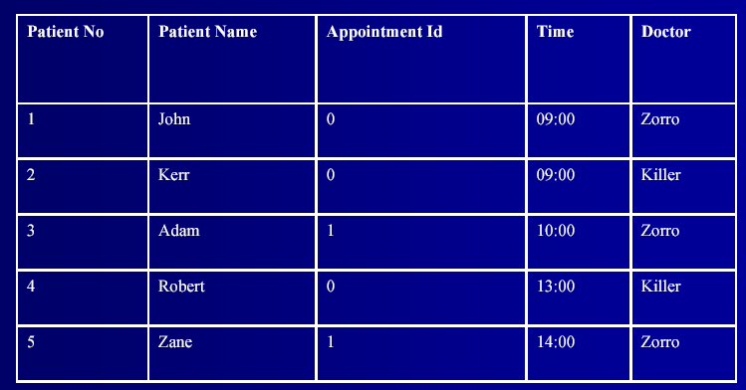
Example

Slide 6
Two possible keys
DB(Patno,PatName,appNo,time,doctor)
Determinants:
- Patno -> patname
- Patno, appNo -> Time,doctor
- Time -> appNo
Two options for 1NF primary key selection:
- DB(Patno,PatName,appNo,time,doctor)
- DB(Patno, PatName,,appNo,time,doctor)

Slide 7
Normalization
DB( Patno,PatName,appNo,time,doctor )
No repeating groups, so in 1NF No repeating groups, so in 1NF
2NF – eliminate partial key dependencies:
  -DB (Patno,appNo ,time,doctor)
  -R1( Patno,PatName)
3NF – no transient dependences so in 3NF
Now try BCNF.

Slide 8
BCNF Every determinant is a candidate key is a candidate key
DB( Patno,appNo,time,doctor)
R1(Patno,PatName)
Is determinant a candidate key?
  Patno -> PatName
Patno is present in DB, but not PatName,so not relevant.
– Patno,appNo -> Time,doctor
All LHS and RHS present so relevant. Is this a candidate key? Patno,appNo IS the key, so this is a candidate key
Time -> appNo
Time is present, and so appNo, so relevant. Is this a
candidate key? If it was then we could rewrite DB as:
DB(Patno,appNo,time,doctor)
This will not work, so not BCNF.

Slide 9
Rewrite to BCNF
DB(Patno,appNo,time,doctor)
R1(Patno,PatName)
BCNF:
DB( Patno,time,doctor)
R1( Patno,PatName)
R2( time,appNo)
time is enough to work out the appointment number of a patient. Now BCNF is satisfied, and the final relations shown are in BCNF

Slide 10
Fourth Normal Form
Under 4NF, a record type should not contain two or more independent multi-valued facts about an entity.
A relation is in 4NF if it is in BCNF and it contains no multi valued dependencies.
A multi-valued fact may correspond to a many-many relationship or to a many-one relationship.
A multi-valued dependency exists when there are three attributes (e.g. A,B, and C) in a relation, and for each value of there is a well-defined set of valued B and a well defined set of values C. However, the set of values of B Is independent of set C and vice-versa.

Slide 11
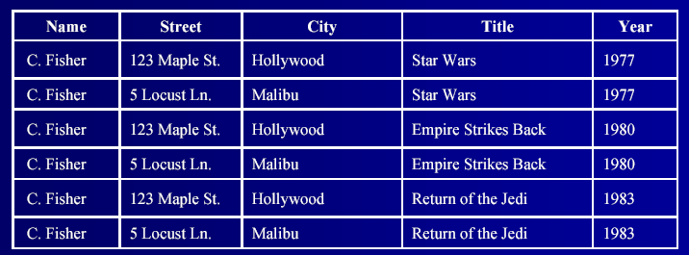
Example
Consider information stored about movie stars. It includes
details of their various addresses and the movies they starred in:
–Name -> Address
–Name -> Movie

Slide 12
Example
Carrie Fisher has two addresses and has been in three movies
The only way to express the fact that addresses and movies are independent is to have each address appear with each movie
– but this has introduced redundancy
There is no BCNF violation
– But the relation is not in 4NF
– We need to break it up into 2 tables

Slide 13
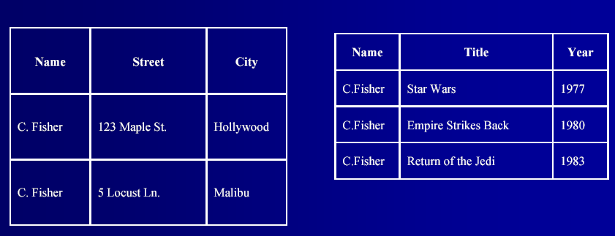
4NF

Slide 14
Fifth Normal Form
5NF is designed to cope with a type of dependency called join dependency
– A relation that has a join dependency cannot be
decomposed by a projection into other relations without
spurious results
– A relation is in 5NF when its information content cannot be reconstructed from several smaller relations
i.e. from relations having fewer attributes than the
original relation

Slide 15
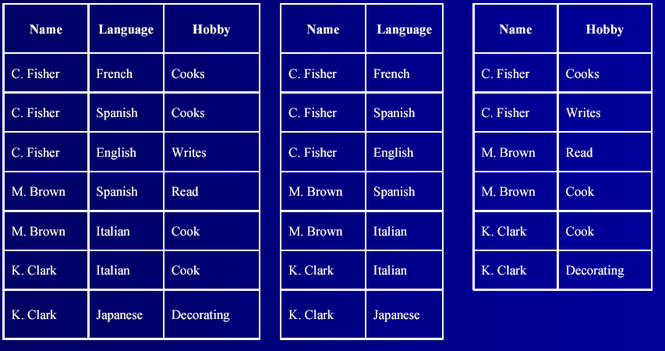
Join Dependency Decomposition

Slide 16
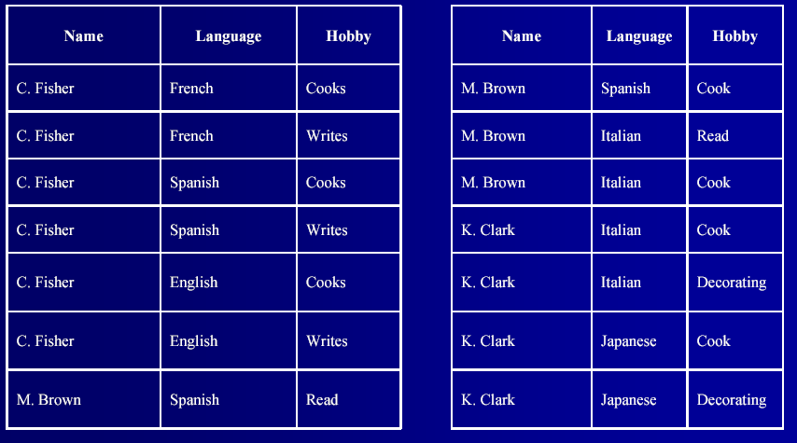
Spurious results

